Slide 1

CIC Model for Cash
Presented by:
Data Science (Bhuvanesh)
3rd July 2025

Slide 2
Architecture Overview of TDB’s Risk Scorecards
For Cash Loan only
For both Cash and SIL
Limit Setting Model (Hosted in Digital Layer)
Credit Decisioning Model (Hosted in Taran)
Beta Stack
Alpha Stack
Trench 1: New Users - within 30 days from TSA Onboarding
Limit Setting Score = Gamma Stack
Beta Demo Score
Beta Demo Score
Gamma Demo Score
Apps Score
Apps Score
Selectively call Alpha
Apps Score
Credo Score
Users automatically move from Trench 1 to Trench 2 after 30 days if no disbursed loans
Credo Score
CIC Score
Gamma Income Model
Beta Income Model
Alpha Income Model
Users will stay in Trench 2 until 1st disbursed loan. His Gamma Stack will be re-calculated every 30-day anniversary from TSA onboarding date
Limit Setting Score = Gamma Stack
Beta Stack
Alpha Stack
Gamma Demo Score
Beta Demo Score
Beta Demo Score
Trench 2: Existing Users - After 30 days from TSA Onboarding AND Never Disbursed Loan
Apps Score
Apps Score
Selectively call Alpha
Apps Score
Transaction Score
Transaction Score
Transaction Score
CIC Score
Gamma Income Model
Beta Income Model
Alpha Income Model
Users will move to Trench 3 after 1st Disbursed Loan
Lowest Risk users from this B Score will be pre-approved for upsell and xsell. Medium Risk users from this B Score will have to go through Taran.
High Risk users from this B Score will not be given any offer.
B Score = Gamma Stack
Trench 3: Existing Users - After 30 days from 1st Disbursed Loan AND current DPD <= 10
Beta Stack
Alpha Stack
Gamma Demo Score
Apps Score
Beta Demo Score
Beta Demo Score
Apps Score
Apps Score
Enhanced Transaction Score
Selectively call Alpha
Enhanced Transaction Score
Once moved to Trench 3, user will forever remain in Trench 3. His Gamma Stack will be re-calculated every 30 days anniversary from 1st Loan Disbursement Date
Enhanced Transaction Score
CIC Score
Gamma Income Model
Beta Income Model
Alpha Income Model

Slide 3
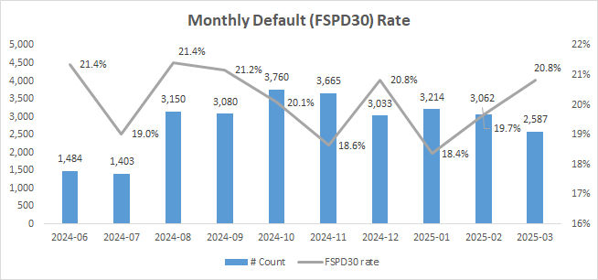
Cash Loan CIC Scorecard
 | Loan Disbursement Date | # Count | # Bad (FSPD30) Cash Loans | FSPD30 rate
Training (90%) | 01/06/2024 - 31/01/2025 | 20,510 | 4,123 | 20.1%
Validation (10%) | 01/06/2024 - 31/01/2025 | 2,279 | 448 | 19.7%
Feb (Test) | 01/02/2025 - 28/02/2025 | 3,062 | 602 | 19.7%
Mar (OOT) | 01/03/2025 - 31/03/2025 | 2,587 | 539 | 20.8%

Slide 4
Feature Selection Methodology Overview
Feature Selection Methodology Overview
166
Feats
112
Feats
103 Feats
60 Feats
15 Feats
Missing Rate < 95%
IV > 0.01
Inter-correlation < 75%
Individual Feature Evaluation

Slide 5
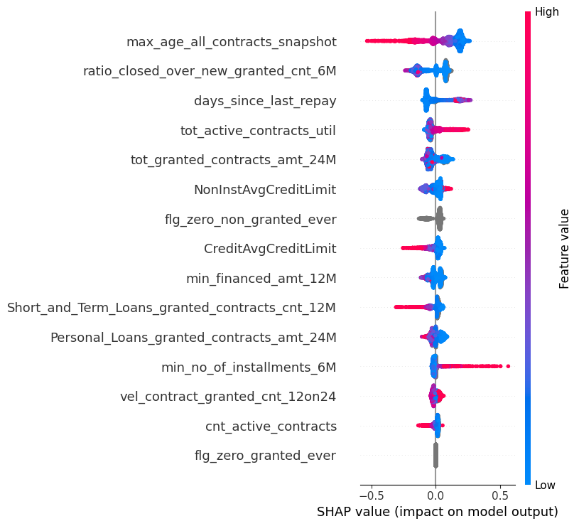
SHAP (15 feat)
Add some bullet point notes on how to read this SHAP chart e.g. left blue right red means +ve correlation; left right right blue means –ve correlation etc.

Slide 6
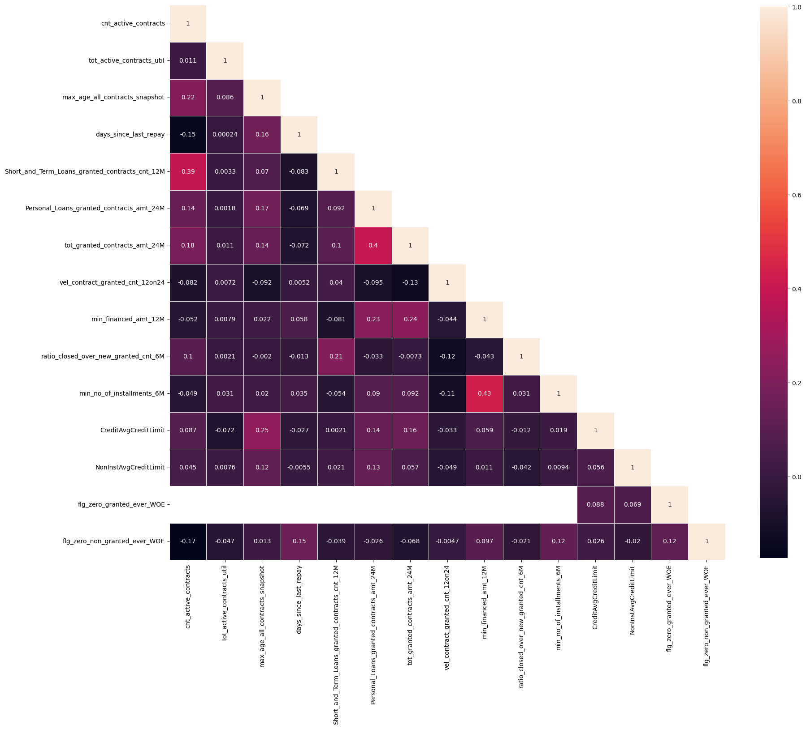
Inter-Correlation (15 feat)
Make sure this chart is clearly visible. You can add any commentary on the left side if needed.
Keep Numerical features as-is and use WOE transformed Categorical features for this plot

Slide 7
Model Iteration | Features | Train (90%) Gini (Jun24 - Jan25) | Val (10%) Gini (Jun24 - Jan25) | Test Gini (Feb25) | OOT Gini (Mar25)
Model with top 4 feat | max_age_all_contracts_snapshot, ratio_closed_over_new_granted_cnt_6M, days_since_last_repay, tot_active_contracts_util | 0.2595 | 0.1723 | 0.1818 | 0.1872
Model with top 5 feat | tot_granted_contracts_amt_24M | 0.2761 | 0.1674 | 0.1802 | 0.2012
Model with top 6 feat | NonInstAvgCreditLimit | 0.2837 | 0.1703 | 0.1894 | 0.2002
Model with top 7 feat | flg_zero_non_granted_ever | 0.2986 | 0.1897 | 0.1937 | 0.2039
Model with top 8 feat | CreditAvgCreditLimit | 0.3063 | 0.1902 | 0.2032 | 0.2181
Model with top 9 feat | min_financed_amt_12M | 0.3138 | 0.2000 | 0.2094 | 0.2272
Model with top 10 feat | Short_and_Term_Loans_granted_contracts_cnt_12M | 0.3116 | 0.1947 | 0.2122 | 0.2373
Model with top 11 feat | Personal_Loans_granted_contracts_amt_24M | 0.3504 | 0.2103 | 0.2216 | 0.2505
Model with top 12 feat | min_no_of_installments_6M | 0.3213 | 0.2004 | 0.2245 | 0.2385
Model with top 13 feat | vel_contract_granted_cnt_12on24 | 0.3356 | 0.2047 | 0.2230 | 0.2432
Model with top 14 feat | cnt_active_contracts | 0.3577 | 0.2066 | 0.2317 | 0.2461
Model with top 15 feat | flg_zero_granted_ever | 0.3621 | 0.2096 | 0.2357 | 0.2517
15 feature model after Hyper Parameters Tuning |  | 0.3234 | 0.2207 | 0.2313 | 0.2505
Add the Hyper Paratemeters as well here

Slide 8
This is a new slide, make sure to add this one here
SHAP Rank Consistency Across Datasets
feature | Train_Rank | Feb_Rank | Mar_Rank
max_age_all_contracts_snapshot | 1 | 1 | 1
ratio_closed_over_new_granted_cnt_6M | 2 | 2 | 2
days_since_last_repay | 3 | 3 | 3
tot_active_contracts_util | 4 | 4 | 4
tot_granted_contracts_amt_24M | 5 | 5 | 5
flg_zero_non_granted_ever | 6 | 7 | 7
NonInstAvgCreditLimit | 7 | 6 | 6
CreditAvgCreditLimit | 8 | 8 | 8
min_financed_amt_12M | 9 | 9 | 9
Short_and_Term_Loans_granted_contracts_cnt_12M | 10 | 10 | 10
Personal_Loans_granted_contracts_amt_24M | 11 | 11 | 11
vel_contract_granted_cnt_12on24 | 12 | 13 | 14
min_no_of_installments_6M | 13 | 12 | 13
cnt_active_contracts | 14 | 14 | 12
flg_zero_granted_ever | 15 | 15 | 15

Slide 9
MoM Average Feature Values Distribution
This is a new slide, make sure to add this one here
Month-on-Month Mean Distribution
Num feature | 2024-06 | 2024-07 | 2024-08 | 2024-09 | 2024-10 | 2024-11 | 2024-12 | 2025-01 | 2025-02 | 2025-03
max_age_all_contracts_snapshot | 1635.6 | 1542.6 | 1440.6 | 1410.4 | 1442.0 | 1464.6 | 1672.4 | 935.6 | 932.8 | 1024.1
ratio_closed_over_new_granted_cnt_6M | 1.6 | 1.5 | 1.5 | 1.6 | 2.1 | 2.6 | 2.8 | 3.1 | 2.6 | 2.2
days_since_last_repay | 345.5 | 322.2 | 279.1 | 295.5 | 307.3 | 270.2 | 178.6 | 165.5 | 189.4 | 177.1
tot_active_contracts_util | 0.7 | 0.7 | 0.8 | 0.8 | 0.8 | 0.8 | 0.9 | 0.7 | 0.7 | 0.6
tot_granted_contracts_amt_24M | 224744.8 | 254410.7 | 223477.5 | 236371.9 | 228915.1 | 238437.4 | 291513.7 | 261343.4 | 264051.3 | 360263.0
NonInstAvgCreditLimit | 16286.6 | 13778.8 | 15993.6 | 15803.4 | 12652.3 | 14168.7 | 13387.2 | 11796.8 | 12138.0 | 10402.0
CreditAvgCreditLimit | 53032.2 | 53125.5 | 48784.8 | 45788.6 | 49137.3 | 46901.0 | 49690.2 | 47215.1 | 50386.5 | 48961.8
min_financed_amt_12M | 32529.3 | 30037.1 | 32426.0 | 26106.4 | 32482.3 | 24578.5 | 14633.0 | 14259.7 | 19282.8 | 13645.0
Short_and_Term_Loans_granted_contracts_cnt_12M | 9.6 | 10.7 | 12.6 | 14.1 | 13.4 | 13.0 | 13.6 | 13.6 | 12.2 | 10.9
Personal_Loans_granted_contracts_amt_24M | 110702.0 | 139129.4 | 100748.2 | 110710.9 | 109534.6 | 99206.8 | 115603.0 | 110116.9 | 106982.0 | 117903.4
min_no_of_installments_6M | 9.6 | 7.4 | 8.1 | 6.6 | 6.5 | 5.3 | 5.7 | 4.8 | 5.5 | 5.0
vel_contract_granted_cnt_12on24 | 1.5 | 1.5 | 1.5 | 1.5 | 1.5 | 1.5 | 1.5 | 1.5 | 1.4 | 1.4
cnt_active_contracts | 4.4 | 4.7 | 4.9 | 5.3 | 5.4 | 5.5 | 6.0 | 5.3 | 5.5 | 6.6
Cat feature | Value | 2024-06 | 2024-07 | 2024-08 | 2024-09 | 2024-10 | 2024-11 | 2024-12 | 2025-01 | 2025-02 | 2025-03
flg_zero_non_granted_ever | 0 | 59.2% | 64.7% | 62.4% | 66.9% | 66.9% | 75.0% | 83.0% | 86.8% | 86.9% | 87.4%
 | 1 | 40.8% | 35.3% | 37.6% | 33.1% | 33.1% | 25.0% | 17.0% | 13.2% | 13.1% | 12.6%
flg_zero_granted_ever | 0 | 95.7% | 93.2% | 96.9% | 97.1% | 97.3% | 96.9% | 97.2% | 95.4% | 98.5% | 98.7%
 | 1 | 4.3% | 6.8% | 3.1% | 2.9% | 2.7% | 3.1% | 2.8% | 4.6% | 1.5% | 1.3%

Slide 10
Feature Evaluation Plots (15 features)

Slide 11
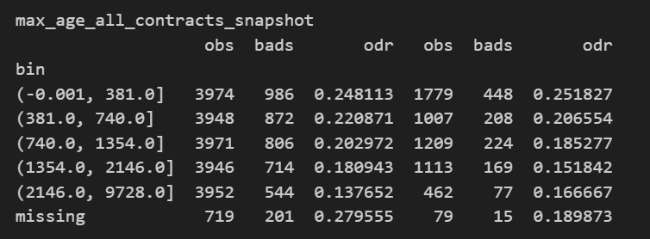
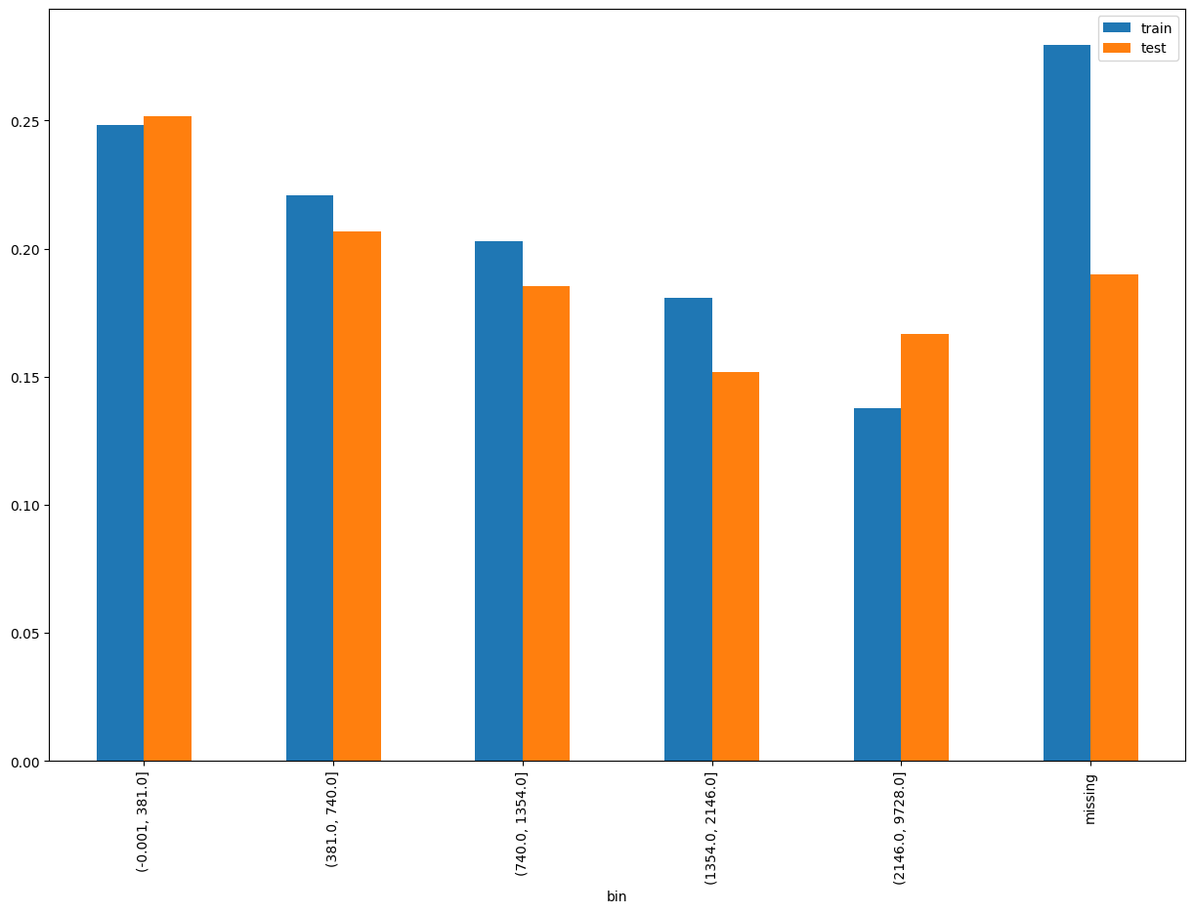
max_age_all_contracts_snapshot (1 / 2)
SHAP Rank: 1
Maximum age (in days) from all loans (active or closed) at the run time. Calculated as either observation date - contract start date (for active) or contract end date - contract start date (for closed).

Slide 12
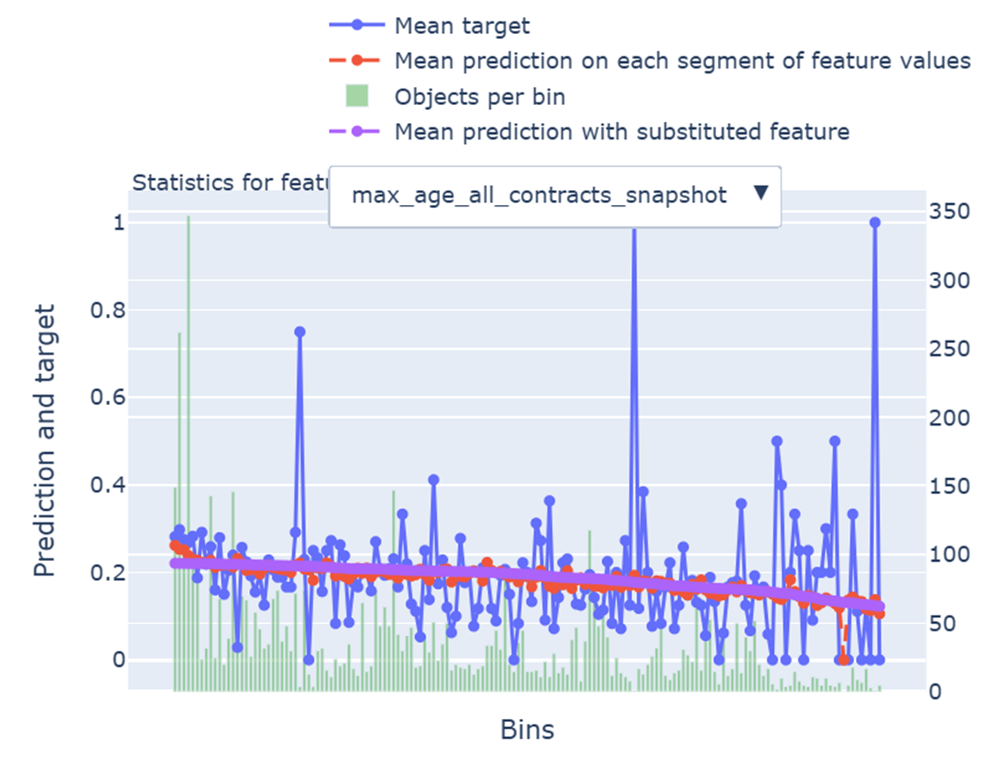
max_age_all_contracts_snapshot (2 / 2)
Add some bullet point note on why this feature is okay to keep in the model. Clearly point out to the business users shich part of the chart to look at, e.g. the red line and purple line are aligned etc.

Slide 13
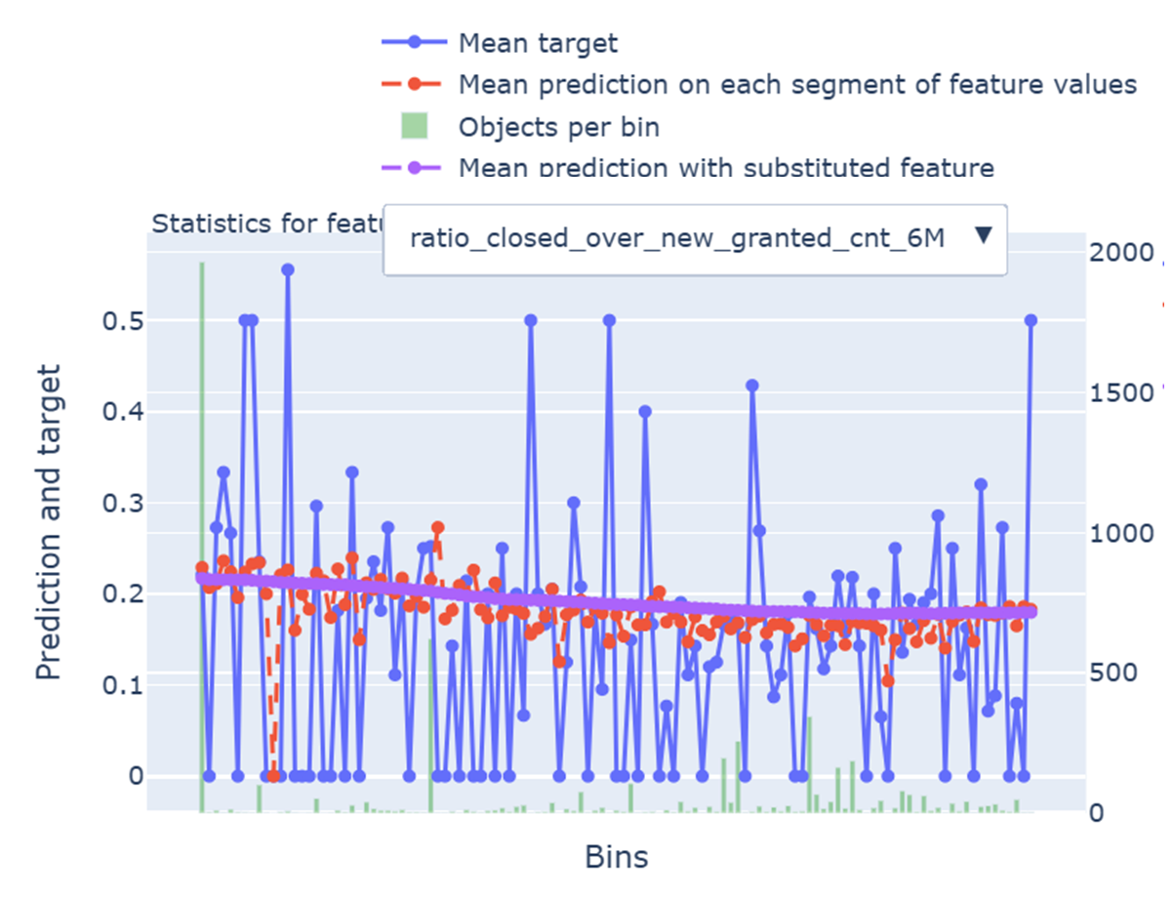
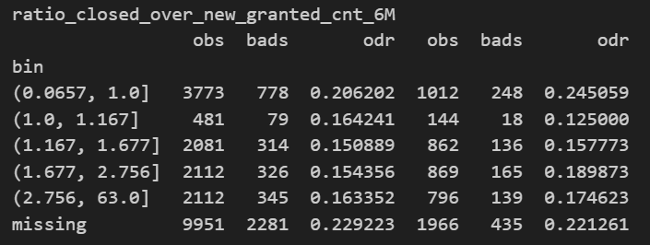
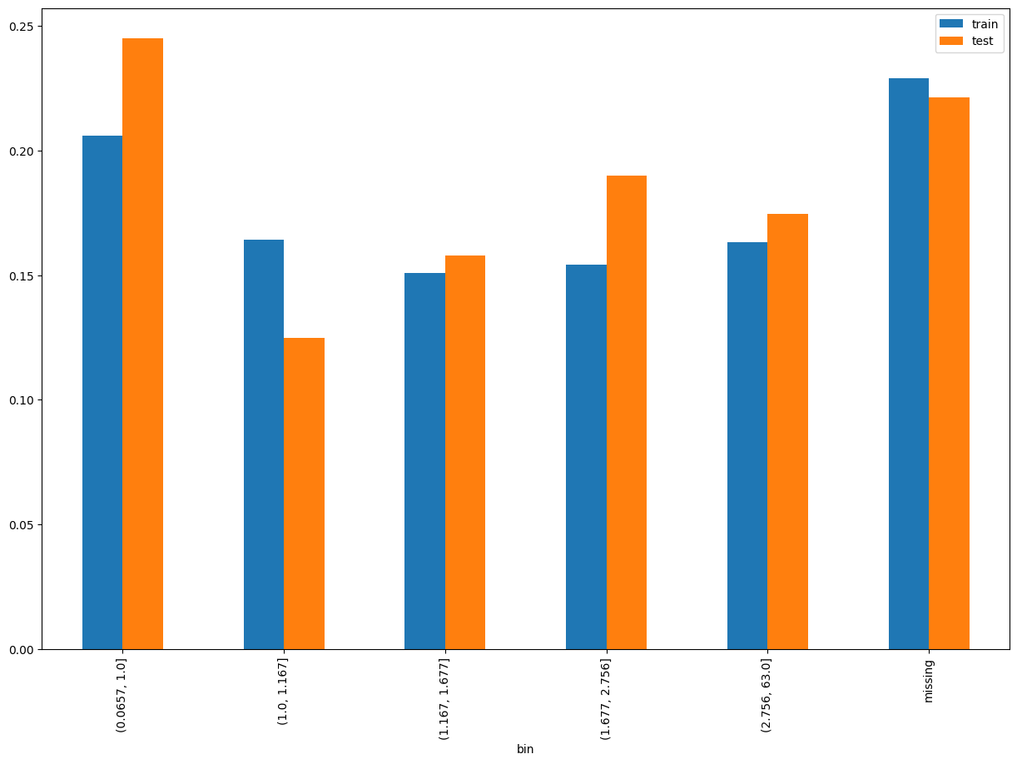
ratio_closed_over_new_granted_cnt_6M
SHAP Rank: 2
Ratio of the number of contracts closed in the last 6 months to the number of new contracts granted in the last 6 months.
Add some bullet point note on why this feature is okay to keep in the model. Clearly point out to the business users shich part of the chart to look at, e.g. the red line and purple line are aligned etc.
As shown before, create a separate slide for this

Slide 14
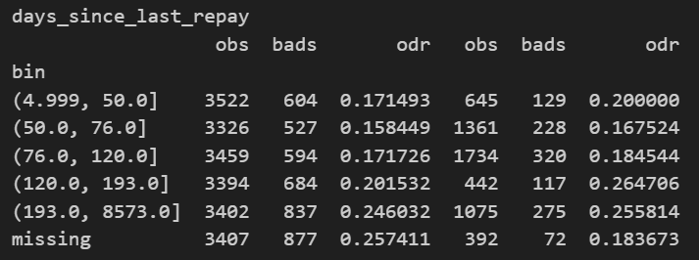
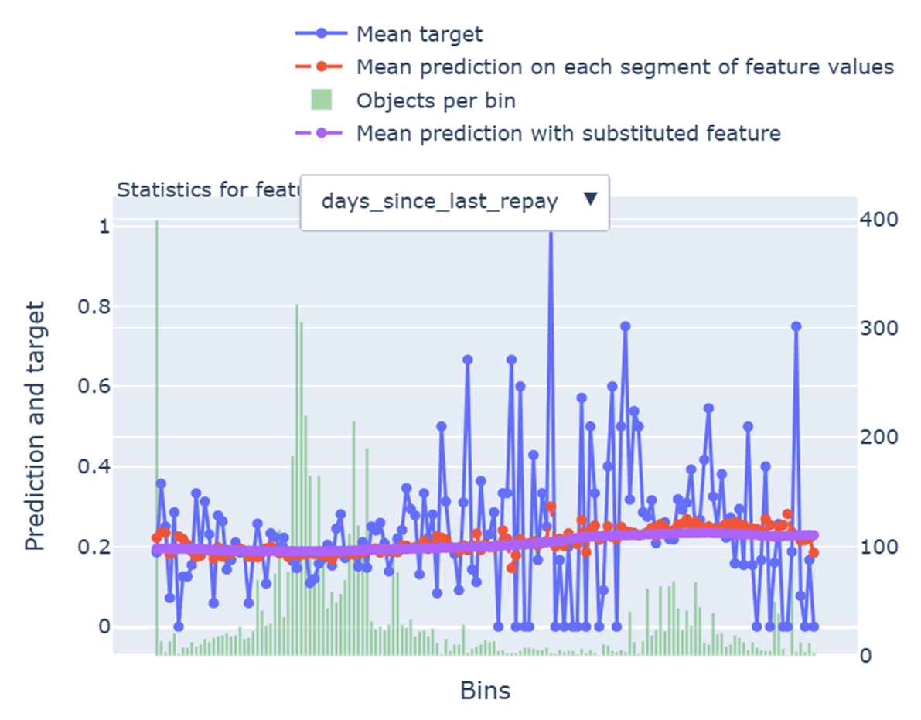
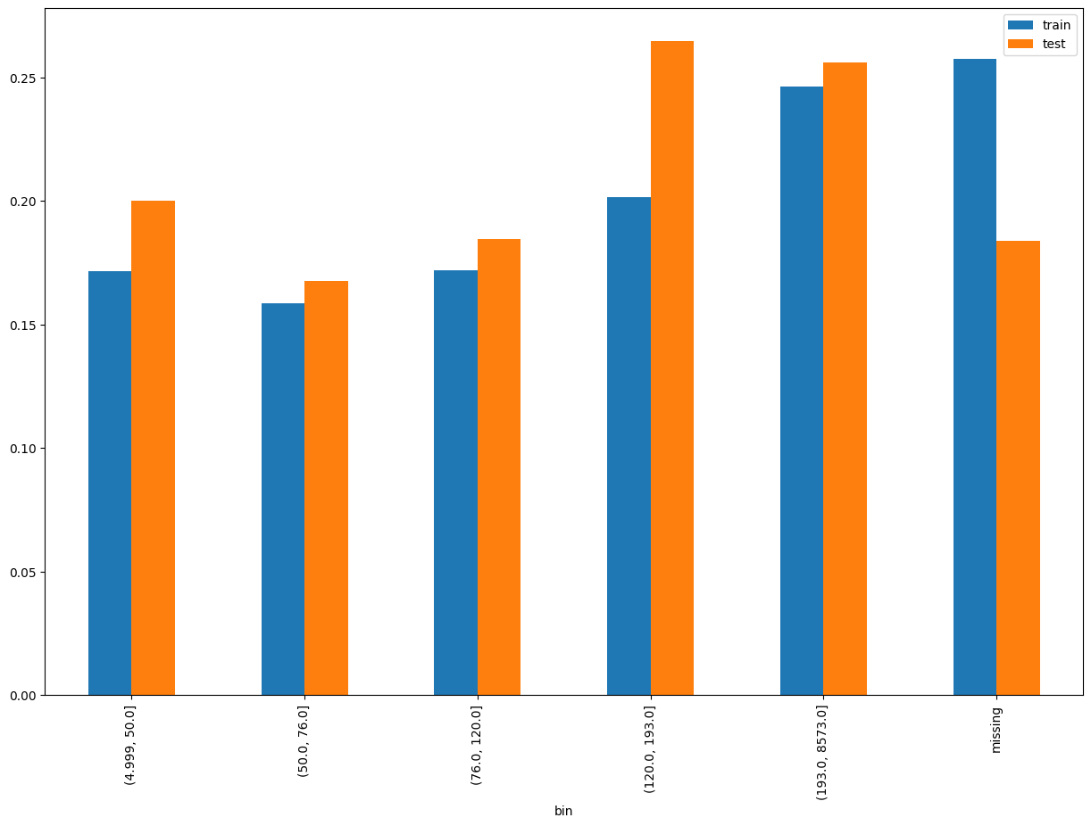
days_since_last_repay
SHAP Rank: 3
Number of days since the most recent repayment date (from any contract) before the observation date.
Add some bullet point note on why this feature is okay to keep in the model. Clearly point out to the business users shich part of the chart to look at, e.g. the red line and purple line are aligned etc.
As shown before, create a separate slide for this

Slide 15
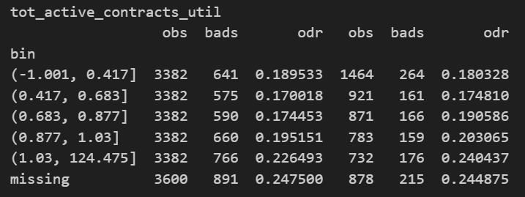
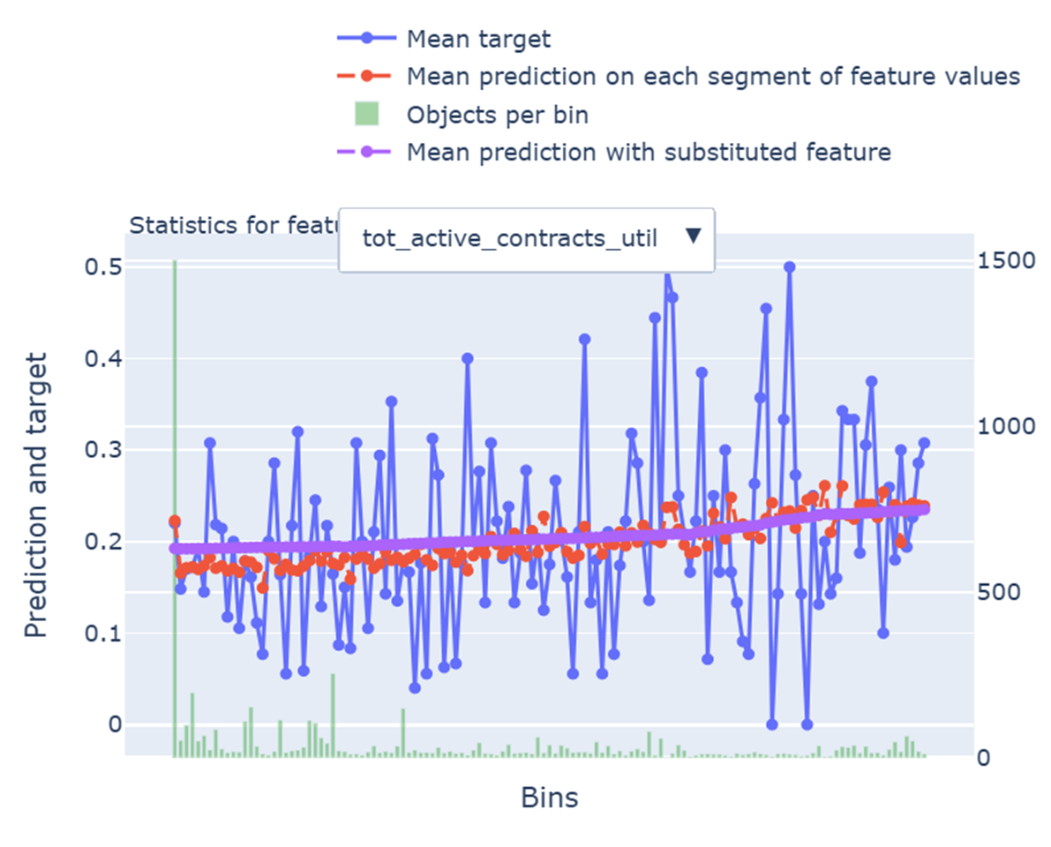
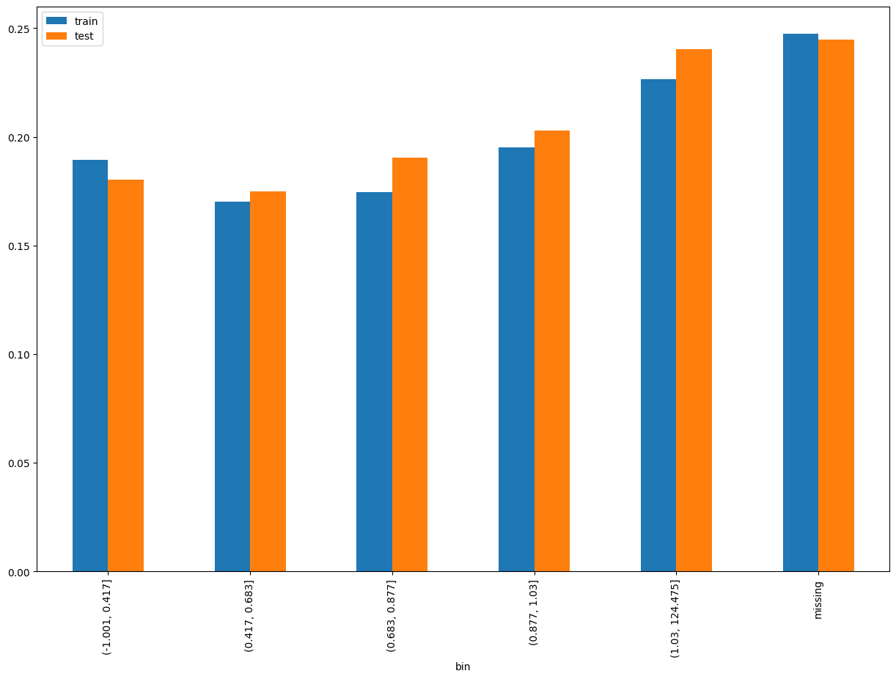
tot_active_contracts_util
SHAP Rank: 4
Total utilization rate from all currently active contracts: sum(Outstanding Balance Amount) / sum(Financed Amount).
Add some bullet point note on why this feature is okay to keep in the model. Clearly point out to the business users shich part of the chart to look at, e.g. the red line and purple line are aligned etc.
As shown before, create a separate slide for this

Slide 16
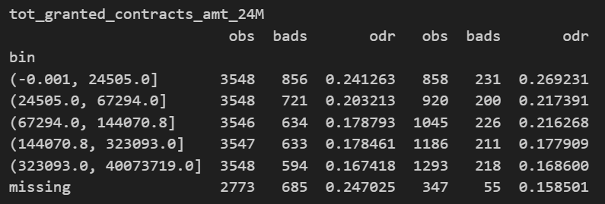
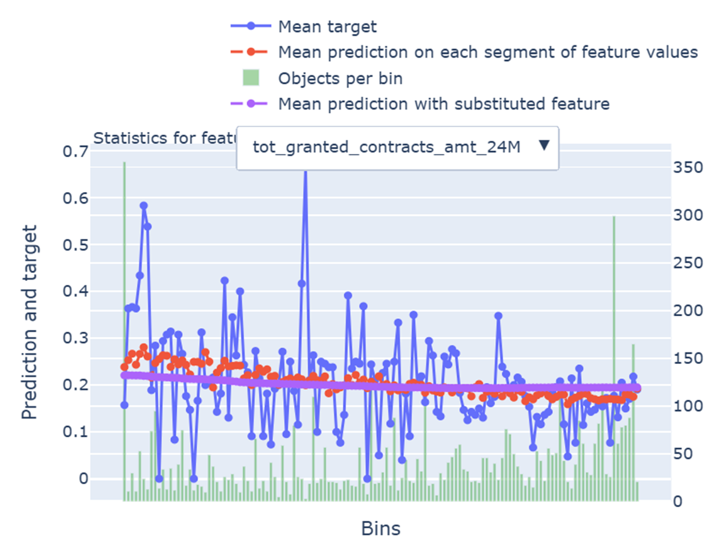
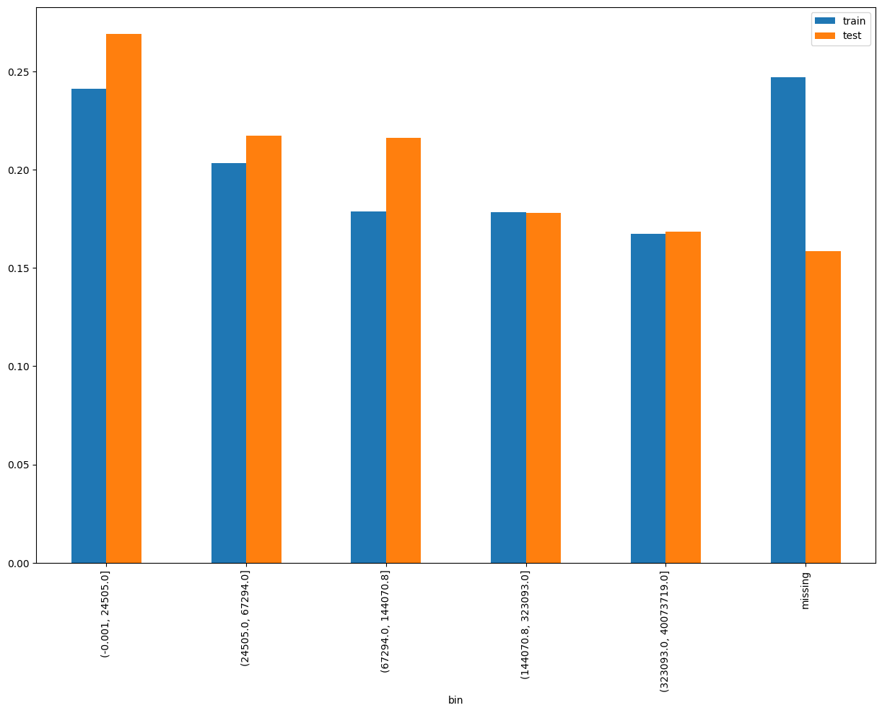
tot_granted_contracts_amt_24M
SHAP Rank: 5
Total amount of loans granted in the last 24 months. Refers to sanctioned or financed amount.
Add some bullet point note on why this feature is okay to keep in the model. Clearly point out to the business users shich part of the chart to look at, e.g. the red line and purple line are aligned etc.
As shown before, create a separate slide for this

Slide 17
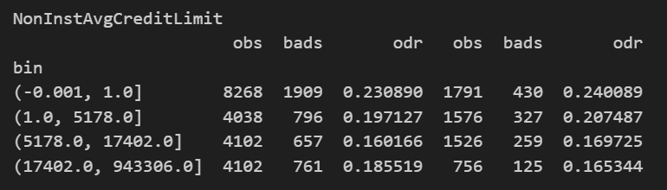
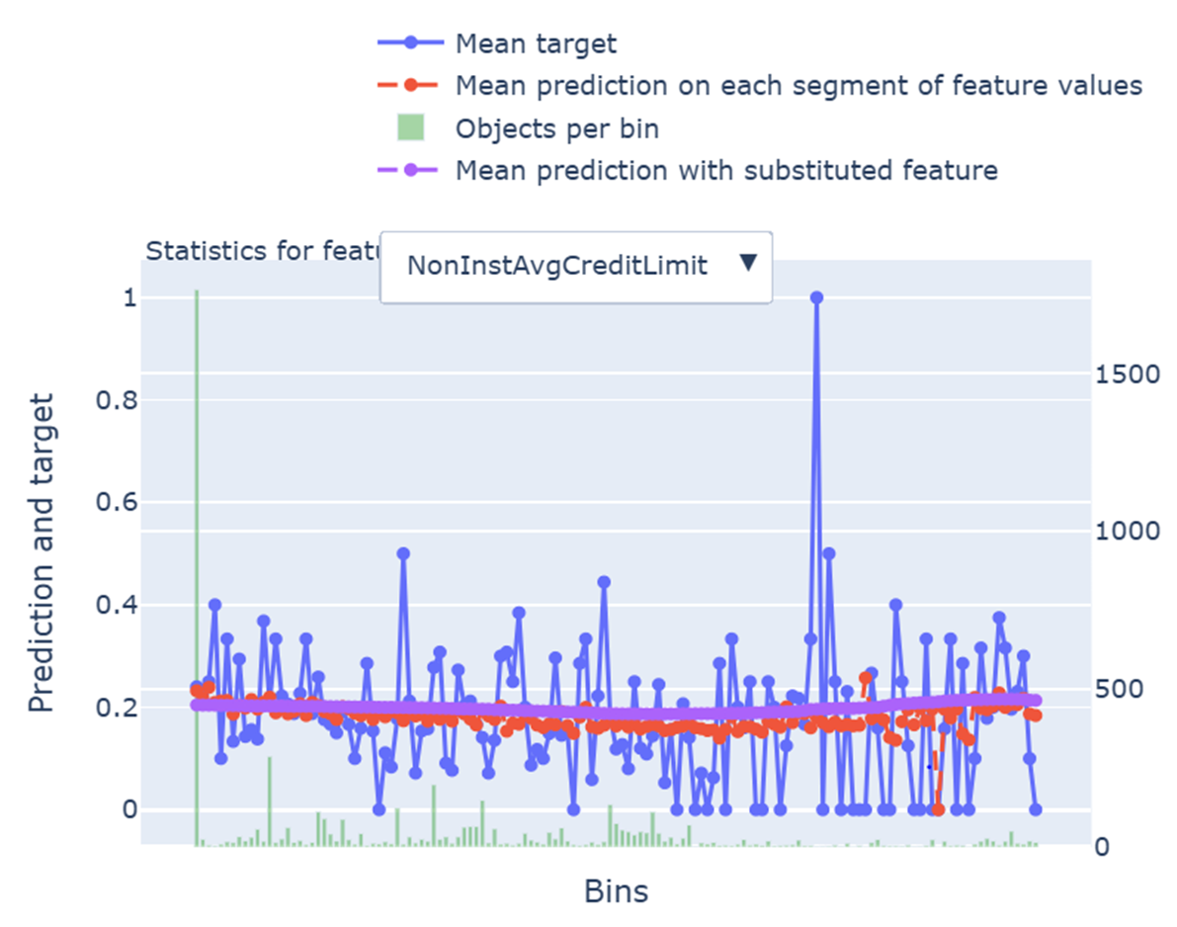
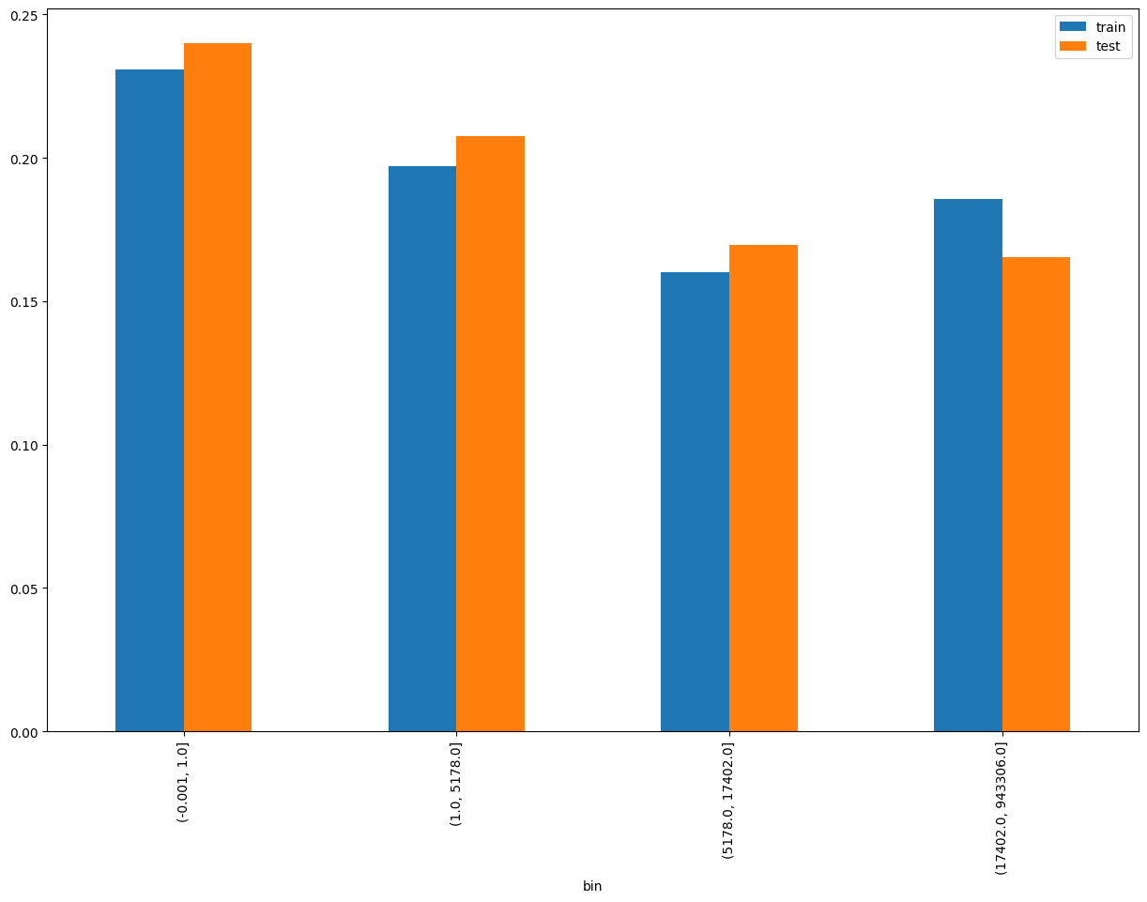
NonInstAvgCreditLimit
SHAP Rank: 6
Average credit limit across non-installment contracts: Total Credit Limit of Non-Installment Contracts / Number of Non-Installment Contracts.
Add some bullet point note on why this feature is okay to keep in the model. Clearly point out to the business users shich part of the chart to look at, e.g. the red line and purple line are aligned etc.
As shown before, create a separate slide for this

Slide 18
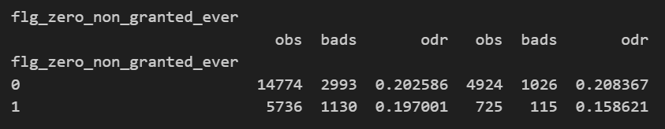
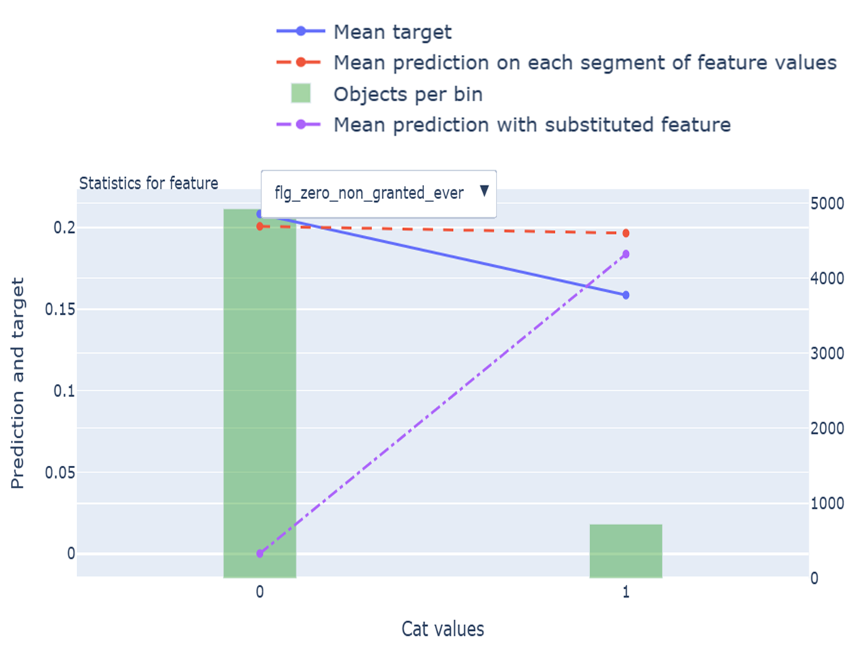
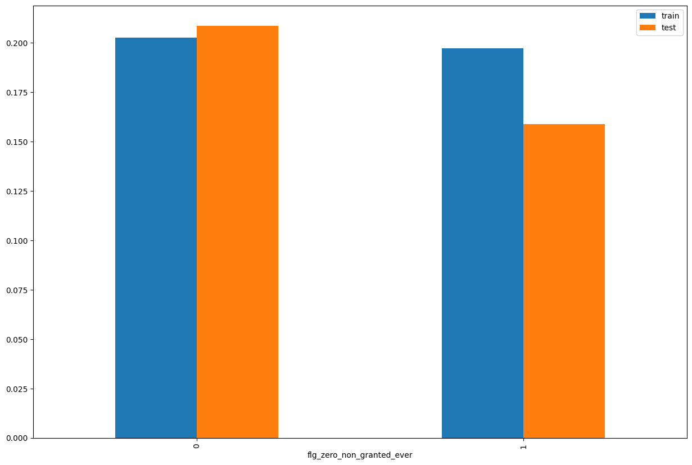
flg_zero_non_granted_ever
SHAP Rank: 7
A flag (likely 1/0) that indicates whether the customer never had any loan applications rejected (i.e., non-granted contracts = 0).
Add some bullet point note on why this feature is okay to keep in the model. Clearly point out to the business users shich part of the chart to look at, e.g. the red line and purple line are aligned etc.
As shown before, create a separate slide for this

Slide 19
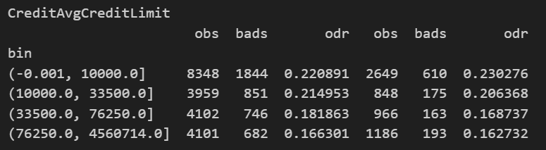
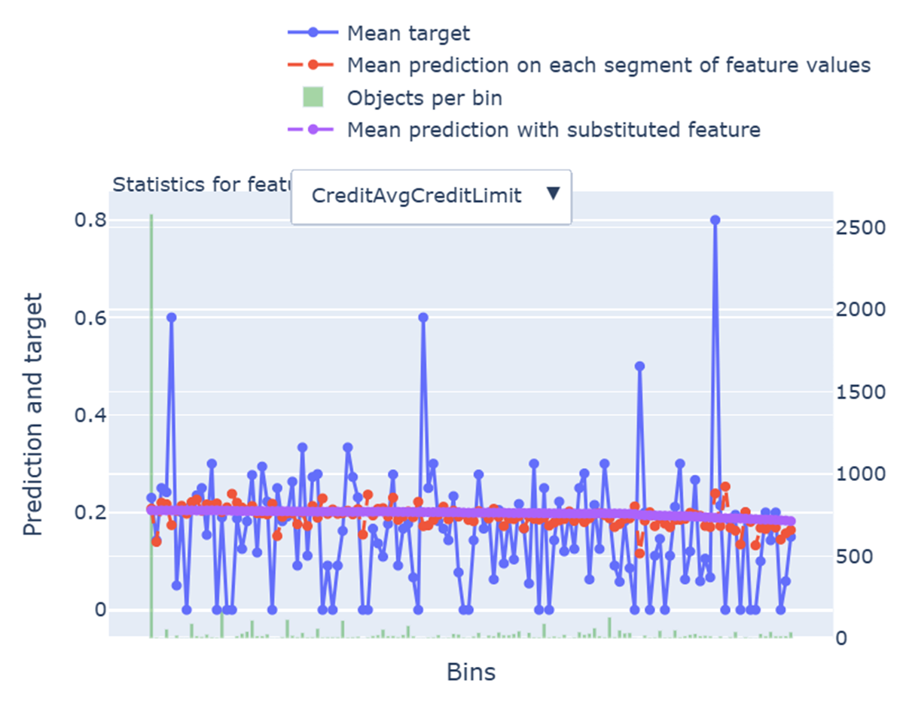
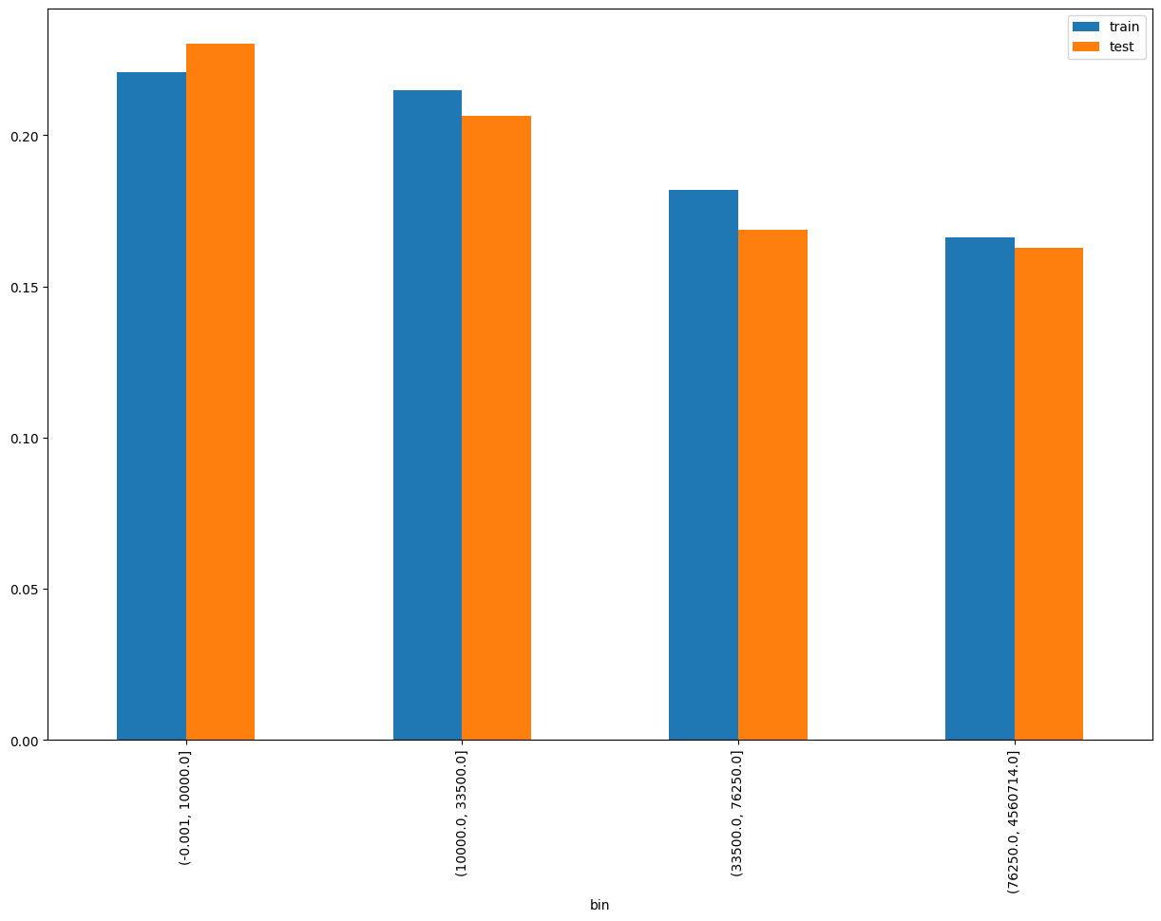
CreditAvgCreditLimit
SHAP Rank: 8
Average credit limit across all credit card lines: Total Credit Limit / Total Number of Credit Card Lines.
Add some bullet point note on why this feature is okay to keep in the model. Clearly point out to the business users shich part of the chart to look at, e.g. the red line and purple line are aligned etc.
As shown before, create a separate slide for this

Slide 20
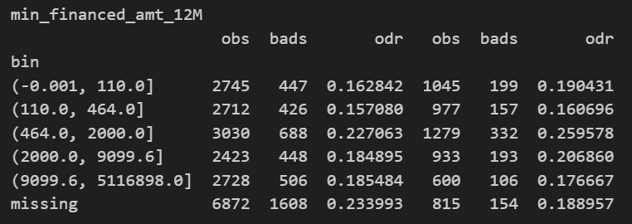
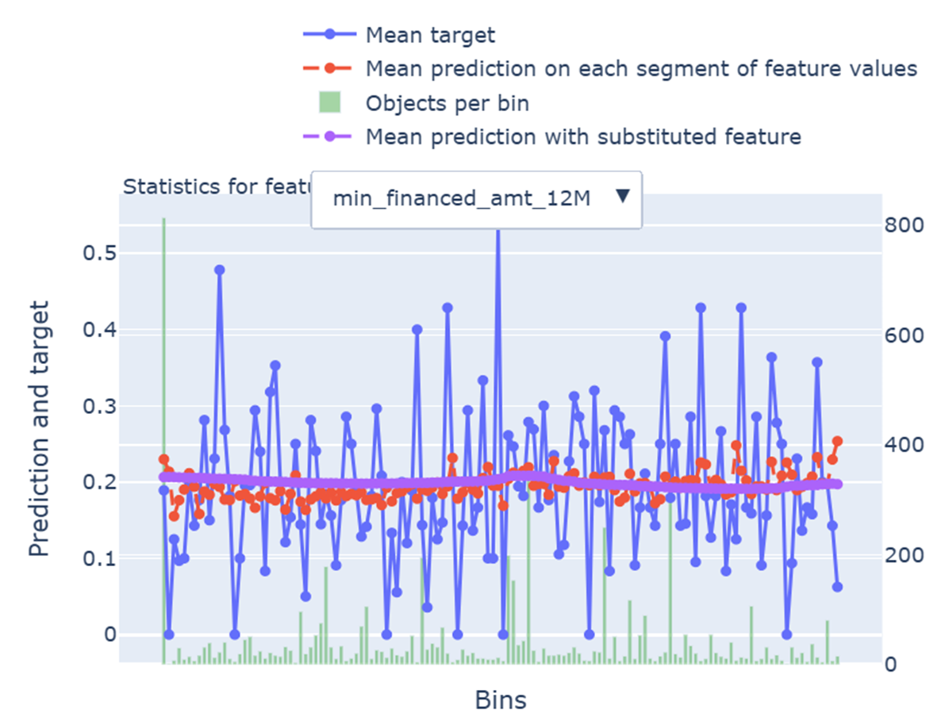
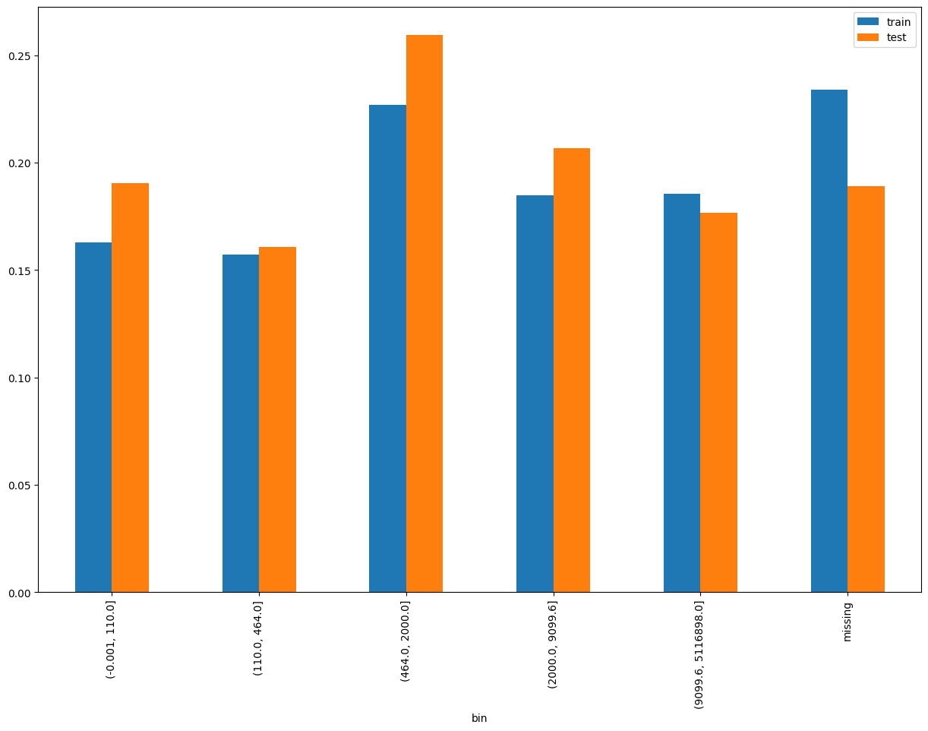
min_financed_amt_12M
SHAP Rank: 9
Minimum financed amount among all loans granted in the last 12 months.
Add some bullet point note on why this feature is okay to keep in the model. Clearly point out to the business users shich part of the chart to look at, e.g. the red line and purple line are aligned etc.
As shown before, create a separate slide for this

Slide 21
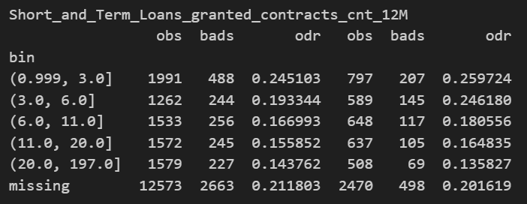
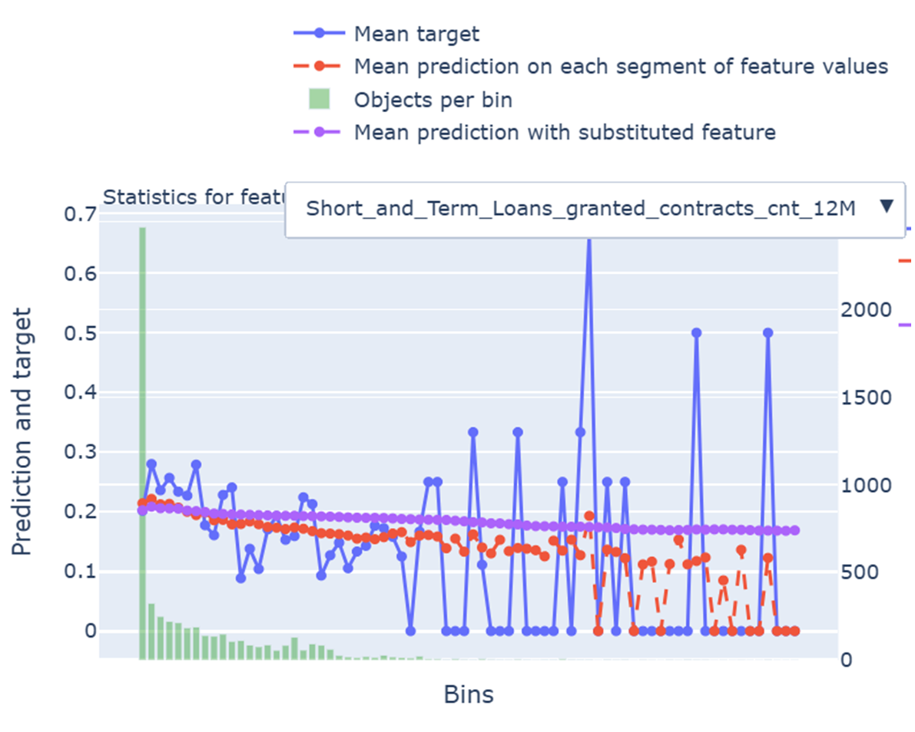
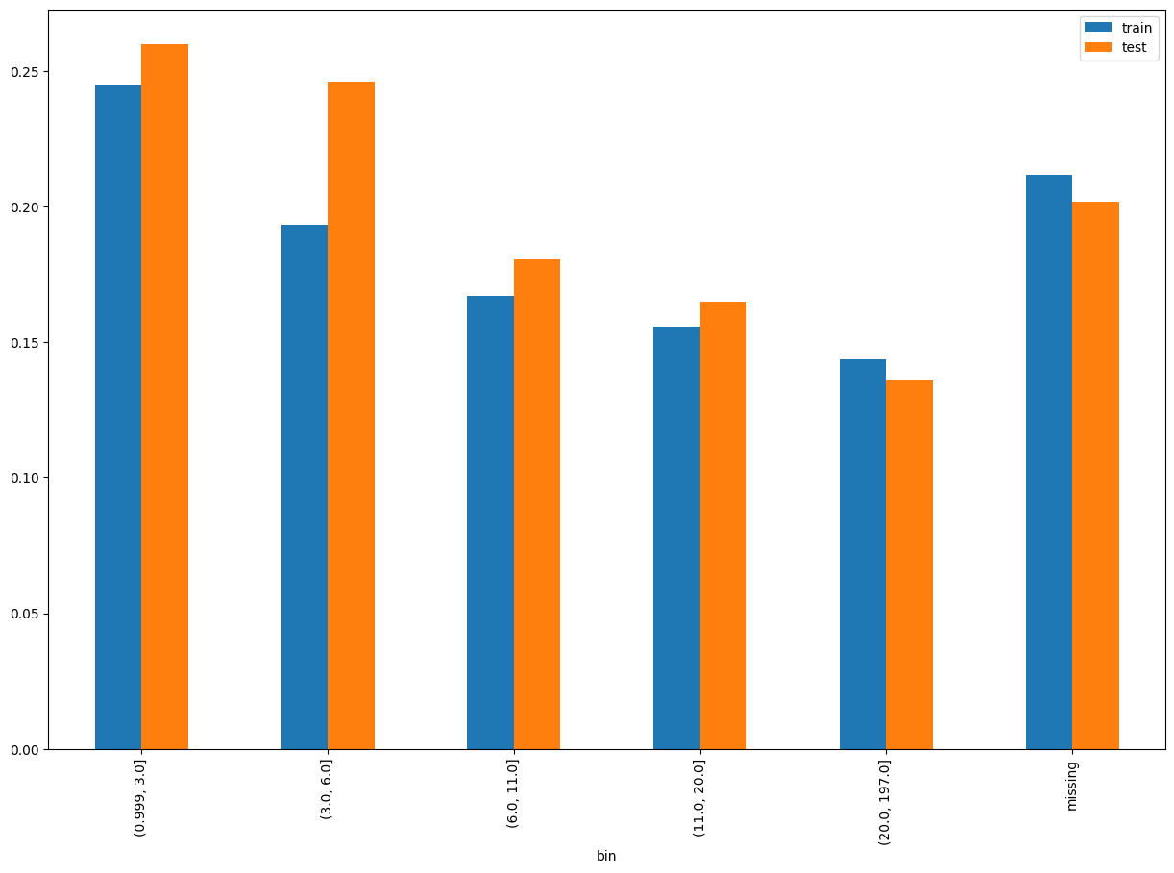
Short_and_Term_Loans_granted_contracts_cnt_12M
SHAP Rank: 10
Count of Short and Term Loans granted in the last 12 months.
Add some bullet point note on why this feature is okay to keep in the model. Clearly point out to the business users shich part of the chart to look at, e.g. the red line and purple line are aligned etc.
As shown before, create a separate slide for this

Slide 22
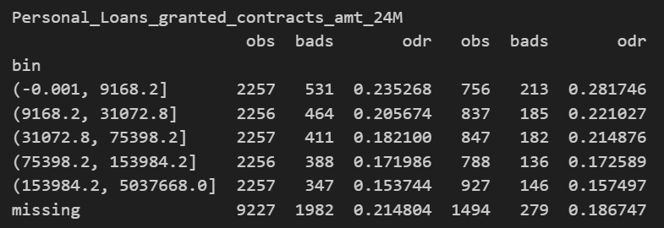
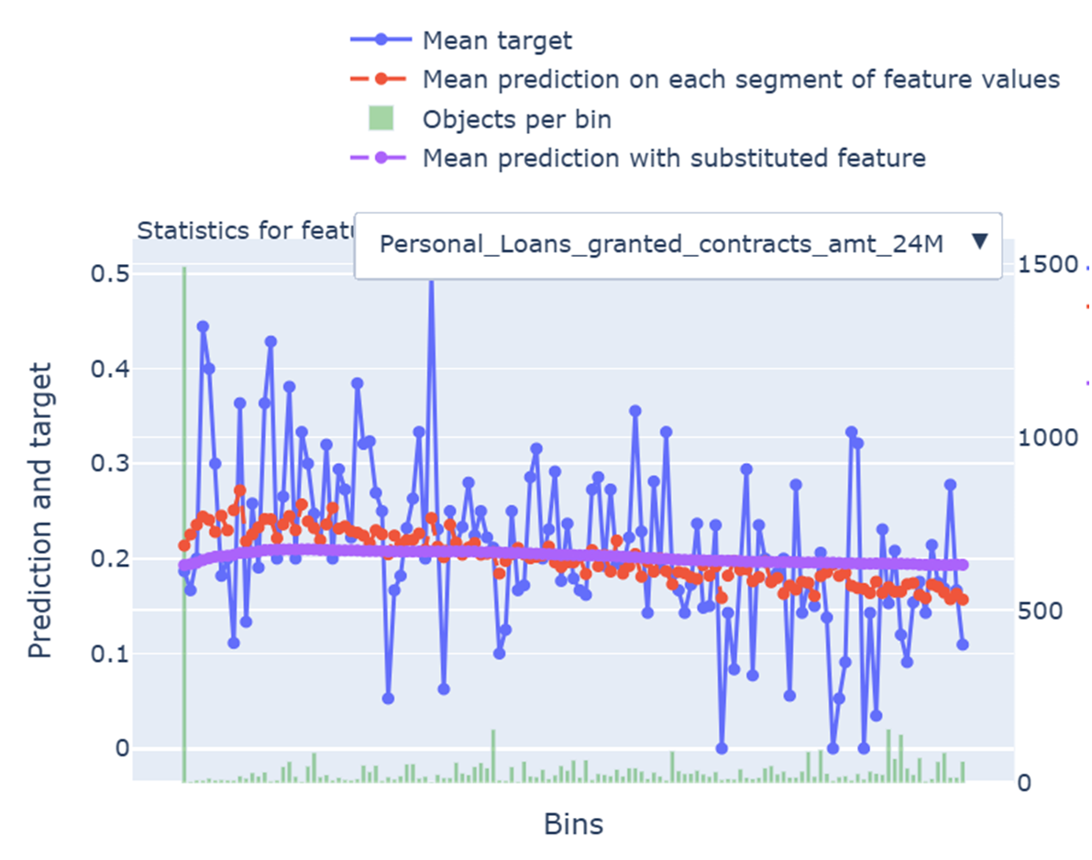
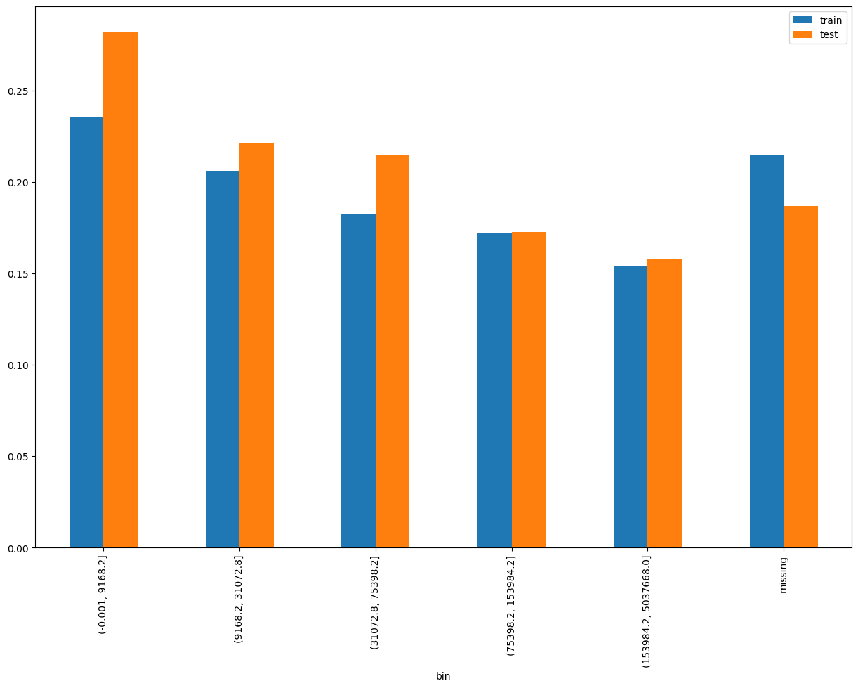
Personal_Loans_granted_contracts_amt_24M
SHAP Rank: 11
Total amount of Personal Loans granted in the last 24 months.
Add some bullet point note on why this feature is okay to keep in the model. Clearly point out to the business users shich part of the chart to look at, e.g. the red line and purple line are aligned etc.
As shown before, create a separate slide for this

Slide 23
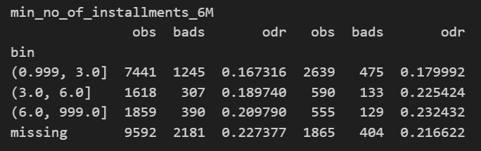
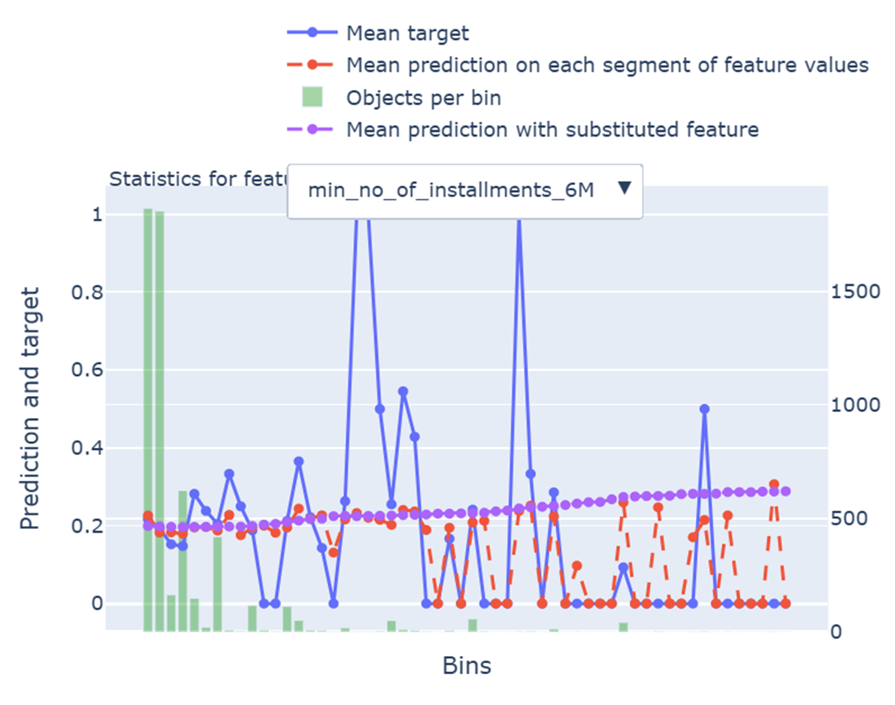
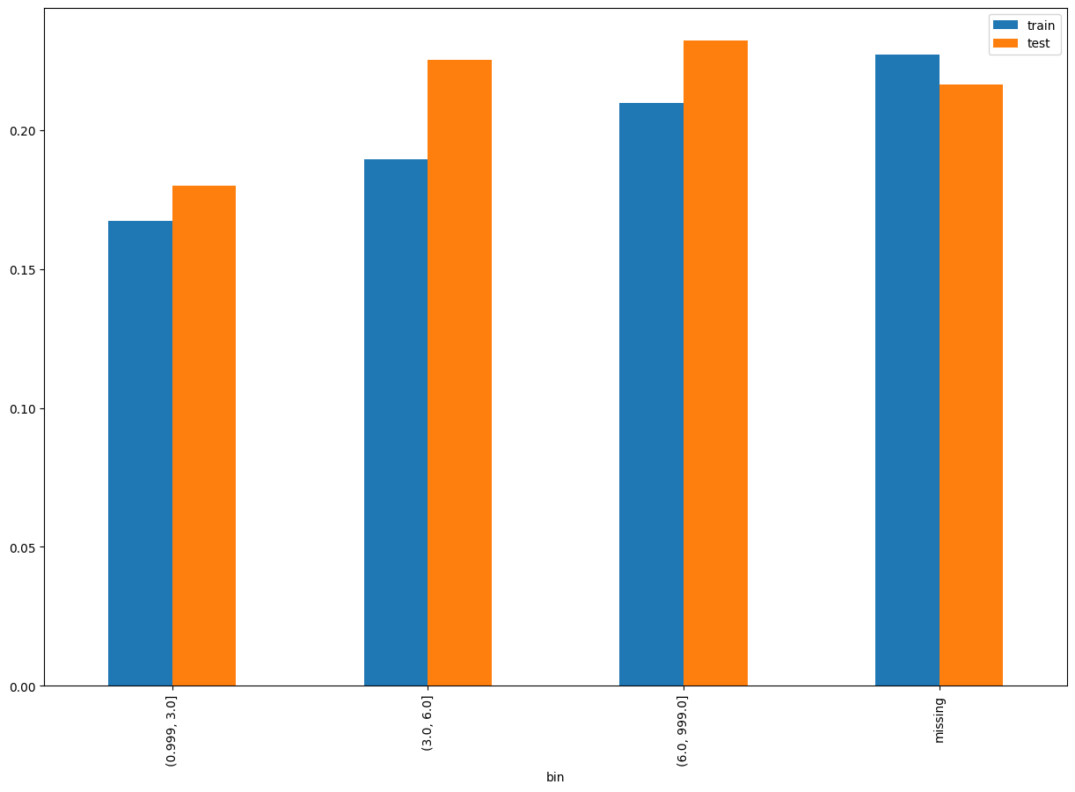
min_no_of_installments_6M
SHAP Rank: 12
Minimum number of installments among loans granted in the last 6 months.
Add some bullet point note on why this feature is okay to keep in the model. Clearly point out to the business users shich part of the chart to look at, e.g. the red line and purple line are aligned etc.
As shown before, create a separate slide for this

Slide 24
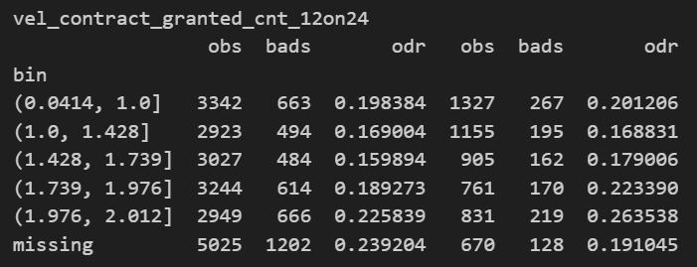
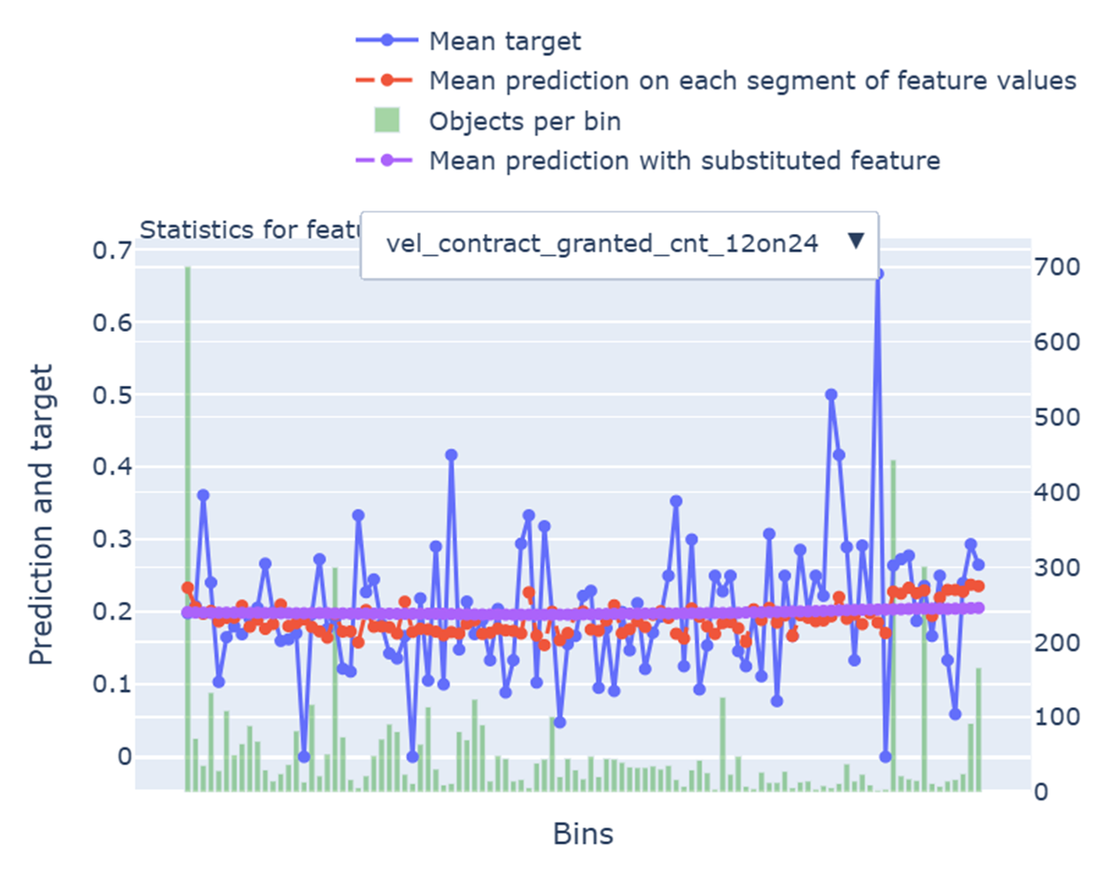
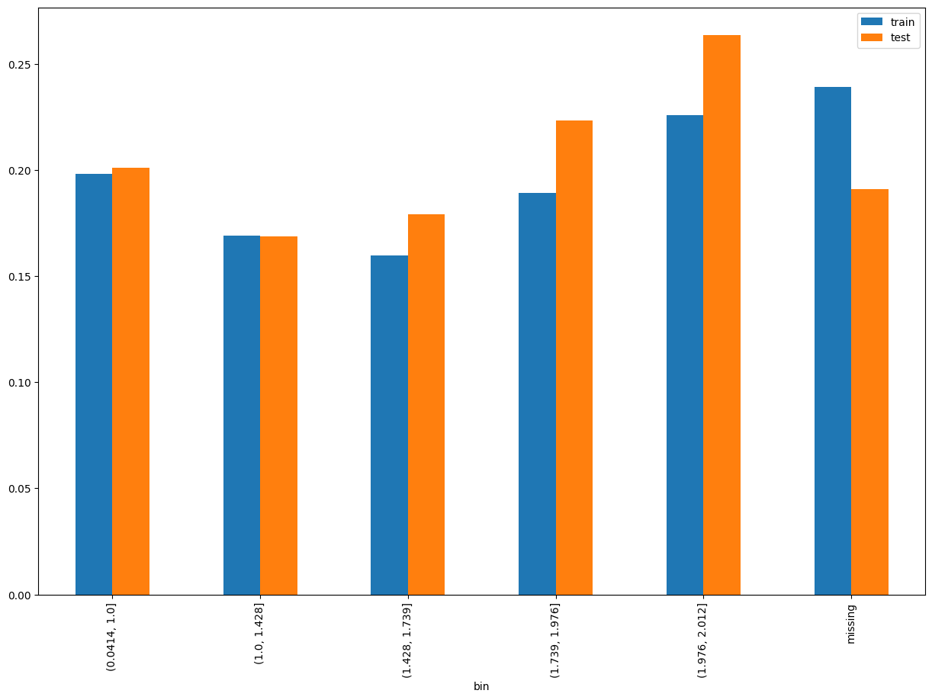
vel_contract_granted_cnt_12on24
SHAP Rank: 13
Ratio of average number of contracts granted in the last 12 months to average granted in the last 24 months.
Add some bullet point note on why this feature is okay to keep in the model. Clearly point out to the business users shich part of the chart to look at, e.g. the red line and purple line are aligned etc.
As shown before, create a separate slide for this

Slide 25
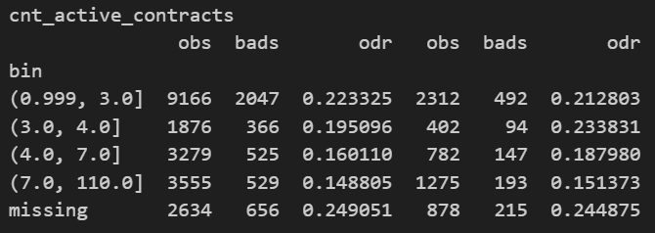
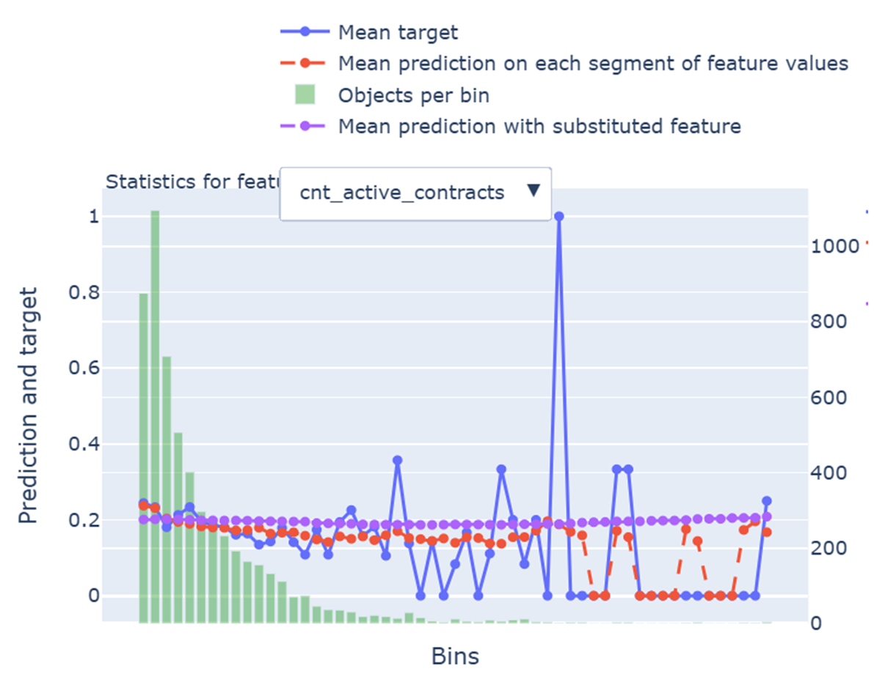
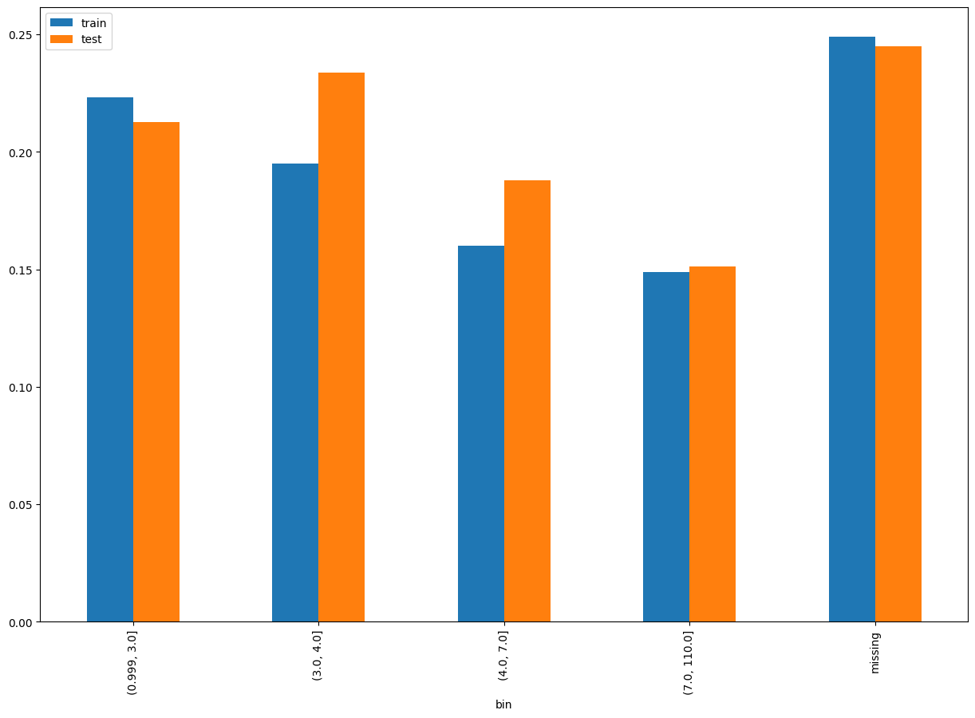
cnt_active_contracts
SHAP Rank: 14
Total number of currently active contracts (open/ongoing loans).
Add some bullet point note on why this feature is okay to keep in the model. Clearly point out to the business users shich part of the chart to look at, e.g. the red line and purple line are aligned etc.
As shown before, create a separate slide for this

Slide 26
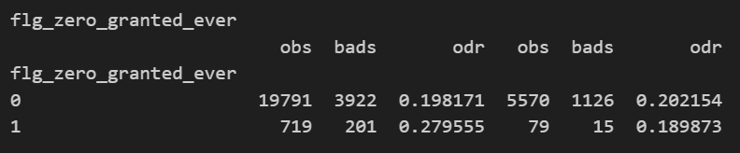
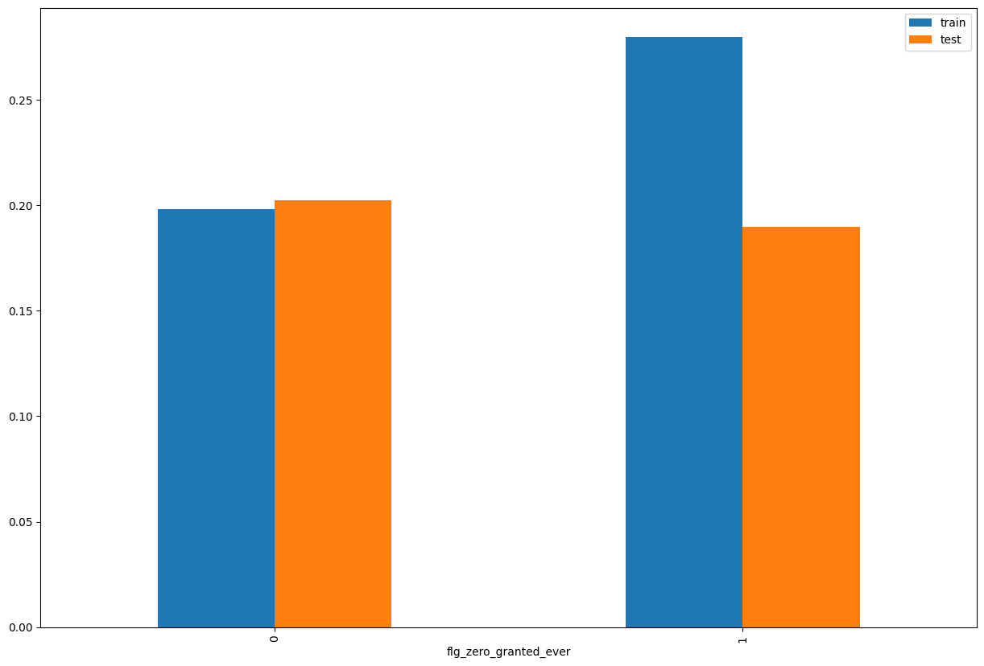
flg_zero_granted_ever
SHAP Rank: 15
A flag that indicates the user never had any granted loans (i.e., granted contracts = 0).

Slide 27

THANK YOU!
​
Questions?
tonikbank.com

